Slide 1
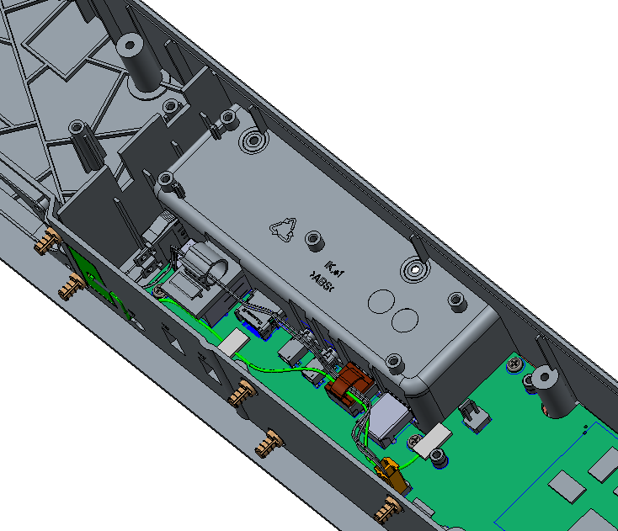
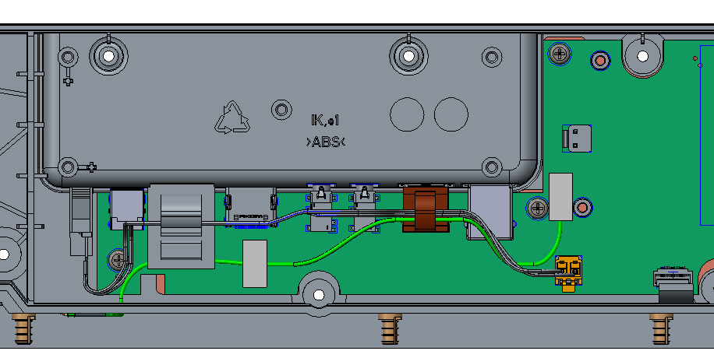
Sponge or polyurethane tape
Wire saddle
Sponge or polyurethane tape
BT antenna
Fix the BT antenna cable to SoC board with sponge and wire saddle.

Slide 2
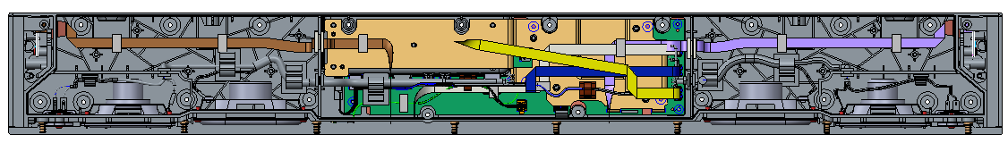
Sponge or polyurethane tape
Fix the FFC cable to bottom cover with sponge.

